Slide 1
CONIC SECTIONS

Slide 2
SPECIFIC OBJECTIVES:
At the end of the lesson, the student is expected to be able to:
• define ellipse
• give the different properties of an ellipse with center at ( 0,0)
• identify the coordinates of the different properties of an ellipse with center at ( 0, 0)
• sketch the graph of an ellipse

Slide 3
THE ELLIPSE (e < 1)
An ellipse is the set of all points P in a plane such that the sum of the distances of P from two fixed points F’ and F of the plane is constant.
The constant sum is equal to the length of the major axis (2a). Each of the fixed points is called a focus (plural foci).

Slide 4

The following terms are important in drawing the graph of an ellipse:
Eccentricity measure the degree of flatness of an ellipse. The eccentricity of an ellipse should be less than 1.
Focal chord is any chord of the ellipse passing through the focus.
Major axis is the segment cut by the ellipse on the line containing the foci a segment joining the vertices of an ellipse
Vertices are the endpoints of the major axis and denoted by 2a.
Latus rectum or latera recta in plural form is the segment cut by the ellipse passing through the foci and perpendicular to the major axis. Each of the latus rectum can be determined by:

Slide 5
Properties of an Ellipse:
1. The curve of an ellipse intersects the major-axis at two points called the vertices. It is usually denoted by V and V’.
2. The length of the segment VV’ is equal to 2a where a is the length of the semi- major axis.
3. The midpoint of the segment VV’ is called the center of an ellipse denoted by C.
4. The distance from the center to the foci is denoted by c.
5. The line segments through F1 and F2 perpendicular to the major – axis are the latera recta and each has a length of 2b²/a.

Slide 6
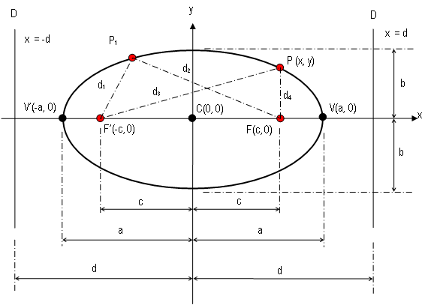
ELLIPSE WITH CENTER AT ORIGIN C (0, 0)

Slide 7
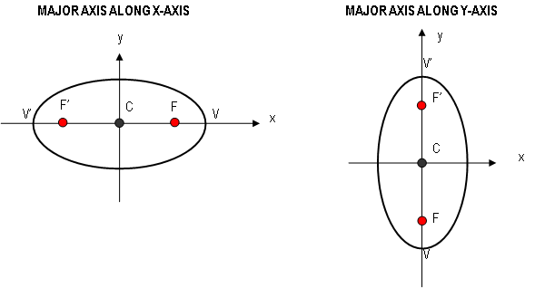


Equations of ellipse with center at the origin C (0, 0)

Slide 8
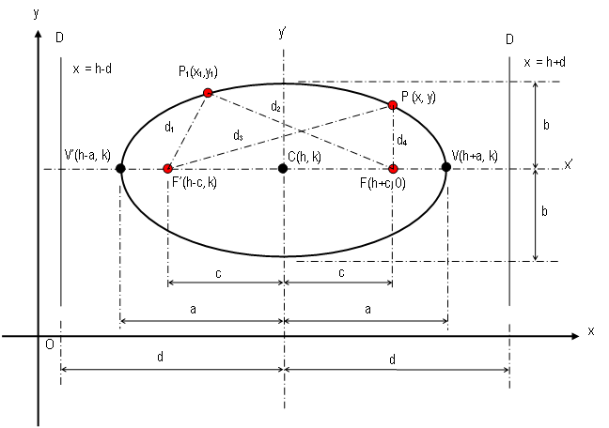
ELLIPSE WITH CENTER AT C (h, k)

Slide 9

ELLIPSE WITH CENTER AT (h, k)
If the axes of an ellipse are parallel to the coordinate axes and the center is at (h,k), we can obtain its equation by applying translation formulas. We draw a new pair of coordinate axes along the axes of the ellipse. The equation of the ellipse referred to the new axes is
The substitutions x’ = x – h and y’ = y – k yield

Slide 10
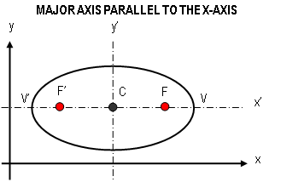
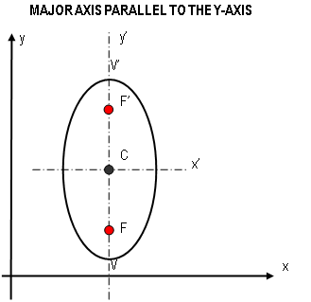


ELLIPSE WITH CENTER AT (h, k)

Slide 11
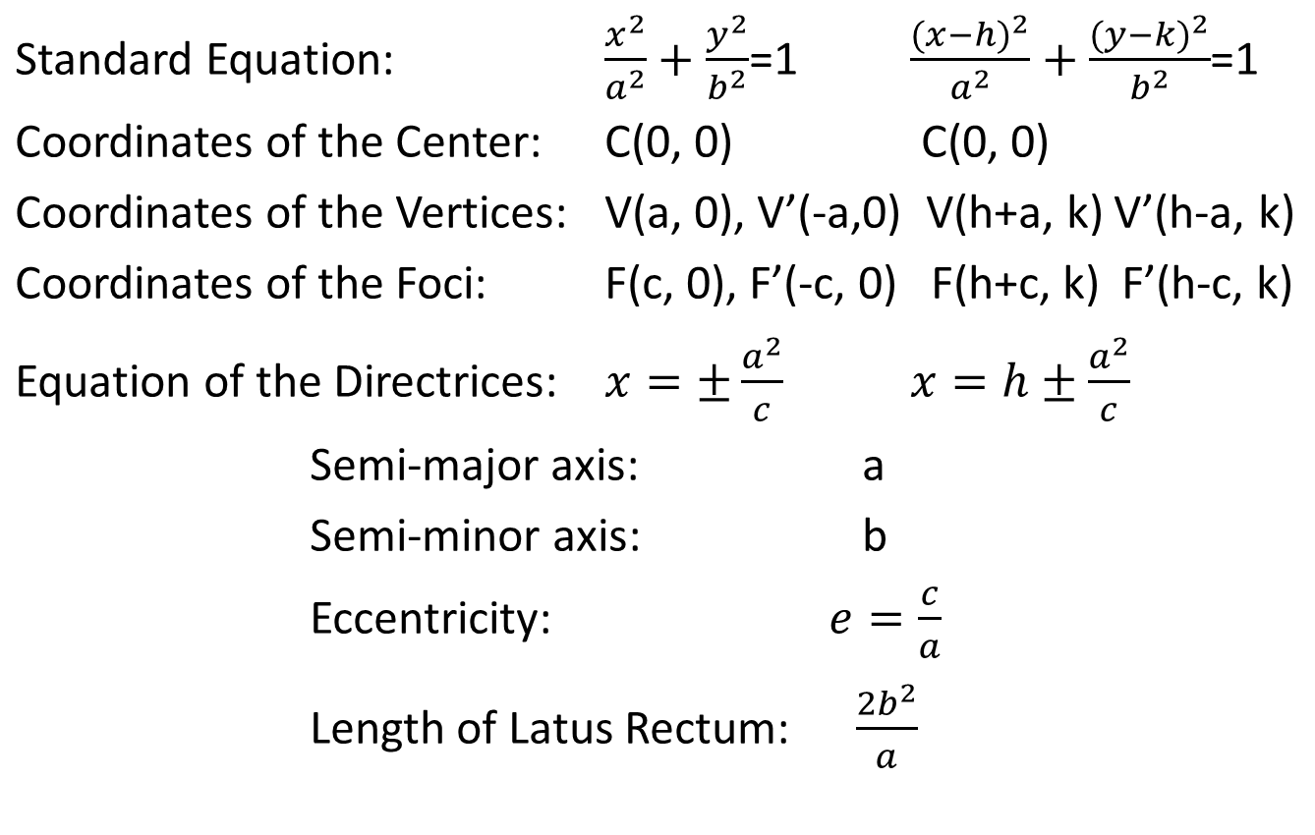
Major Axis Parallel to the X-axis

Slide 12
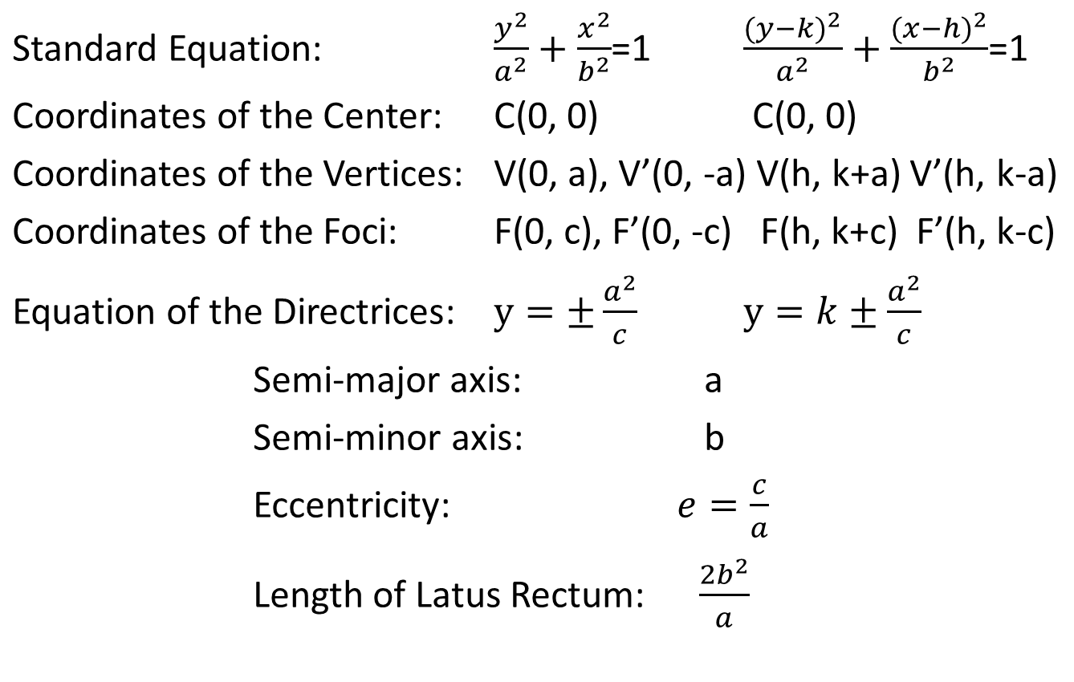
Major Axis Parallel to the Y-axis

Slide 13
Sample Problems:
Sketch the graph of the ellipse:
a. 9x² + 16y² – 576 = 0
  b. 4x² + 9y² - 48x + 72y +144 = 0
2. Find the equation of the ellipse which satisfies the ffg. conditions:
a. with C(0, 0), one focus at (0, 3) and the length of the major axis is 10.
b. with C(0, 0), major axis on y-axis, distance between foci is 5 and distance between directrices is 25.
c. C(0, 0), major axis on x-axis, one endpoint of its latus rectum is at (5, 10).
d. center (-2, 2), vertex (-6, 2), one end of minor
axis (-2, 0).

Slide 14
Application:
e. foci (-6, 3) and (2, 3), one end of minor axis at (-2, 0).
3. An arch is built in the form of a semi-elliptical arc 100 m wide at the bottom and 20 m high. A horizontal roadway is 6 m above the top of the arch. How high is the roadway at a point 30 m from the center.
4. A parabola and a semi-ellipse lie on the same base with a width of 100 m and height 60 m. Taking the x-axis as the common base, find the difference in ordinates of the two at a point 40 m from the center.

Slide 15
End of Discussion

Slide 16





ELLIPSE WITH CENTER AT ORIGIN C (0, 0)
d₁ + d₂ = 2a
Considering triangle F’PF
d₃ + d₄ = 2a
d₃ = 2a – d₄

Slide 17
